Slide 1
Typosquatting Lab

Slide 2
Typosquatting Lab
Materials needed
Kali Linux Virtual Machine
Windows 7 Virtual Machine
Software tool used
wget (Linux Command Line Tool)
Leafpad (Linux application)

Slide 3
Objectives Covered
Security+ Objectives (SY0-501)
Objective 1.2 – Compare and contrast types of attacks
Application/service attacks
Hijacking and related attacks
Typo squatting
DHS CAE Units
CTH – Describe different types of attacks and their characteristics

Slide 4
What is Typosquatting?
Typosquatting is exploiting a user’s misspelling
Could type www.facbook.com instead of www.facebook.com
What if a user goes to www.waether.com instead of www.weather.com
This is also known as cybersquatting
A malicious user will buy one of these domain names in the hope that someone will visit this website accidentally

Slide 5
The Typosquatting Lab
Setup Environments
Find Kali’s IP Address
Copy www.cyber.org
Access Website
Create Typosquatting Website
Create Malicious File
Edit the Typosquatting Website
Access Typosquatting Website

Slide 6
Setup Environments
Log into your range
Open the Kali Linux and Windows 7 Environments
You should be on your Kali Linux Desktop
You should also be on your Windows 7 Desktop

Slide 7

Find the IP Address (Kali Machine)
You will need the IP address of the Kali machine
Open the Terminal
In the Linux VM, open the Terminal and type the following command:
hostname -I
This will display the IP Address
Write down the Kali VM IP address
The IP Address

Slide 8
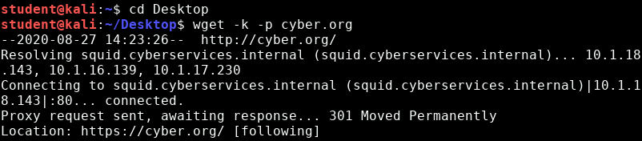
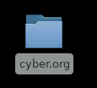
Copy www.cyber.org
Open a new Terminal in Kali
Navigate to the Desktop
cd Desktop
Copy www.cyber.org’s files/webpage
wget -k -p cyber.org
You should see this folder appear on the Desktop that contains all of the files of www.cyber.org

Slide 9
Access Website
Copy the cyber.org files to the Apache servers
sudo cp -r cyber.org /var/www/html
Start the Apache server
sudo service apache2 start

Slide 10

Access Website
Go to the Windows 7 Environment
Open a web browser
Like Google Chrome
Go to the following URL
<Your-Kali-IP-Address>/cyber.org
You should see this website load

Slide 11
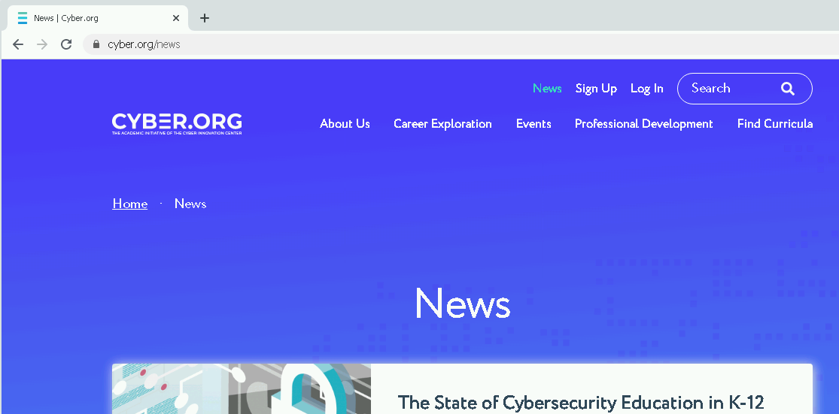
Access Website
In the website, click on the “News” option
This should open up cyber.org/news

Slide 12
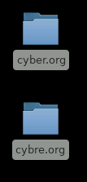
Create Typosquatting Website
Now, create a malicious website
Go back to the Kali machine, in the terminal copy all the cyber.org files on the desktop
cp -r cyber.org cybre.org
Here, the misspelling is going to be cybre.org instead of cyber.org

Slide 13
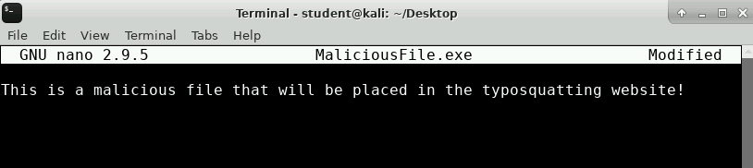
Create Malicious File
Create a malicious file
touch MaliciousFile.exe
Add some text to the MaliciousFile.exe
nano MaliciousFile.exe
Add some text
CTRL+x, y, ENTER to exit

Slide 14
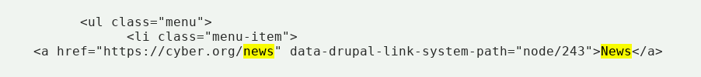
Edit the Typosquatting Website
Open the cybre.org HTML file in Leafpad
leafpad cybre.org/index.html
Find the code that controls the News link
Can search for “news” to help find this line!
Find this line of code, this is the link for the News button

Slide 15
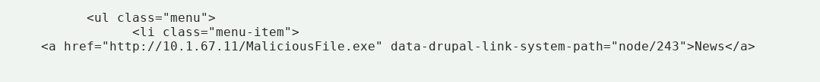
Edit the Typosquatting Website
Change the “https://cyber.org/news” link to the following:
http://<Your-Kali-IP-Address>/MaliciousFile.exe
Change this link
Make sure to save the HTML file when done!

Slide 16
Move Typosquatting Website
Copy the files to the Apache server
sudo cp -r cybre.org /var/www/html
sudo cp MaliciousFile.exe /var/www/html

Slide 17

Access Typosquatting Website
Go to the Windows 7 Environment
Open a web browser
Like Google Chrome
Go to the following URL
<Your-Kali-IP-Address>/cybre.org
Here, the user misspells cyber
You should see this website load, looks just like the original website

Slide 18
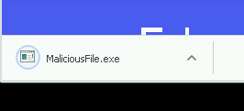
Access Typosquatting Website
In the website, click on the “News” option
You should see the MaliciousFile.exe download
Obviously this MaliciousFile.exe is not harmful, but an unsuspecting user might trust this website because it looks exactly like the cyber.org website.
In the real world, this file is probably going to be harmful to your system!
MaliciousFile.exe downloaded

Slide 19
Defend Against Typosquatting
Always check your domain names!
Companies will actually purchase the domains of common typos to protect users
For example, go to www.gooogle.com
It will re-direct you to Google
Go to www.facbook.com
It will re-direct you to Facebook
Go to mikerowesoft.com
It will re-direct you to Microsoft’s website

